Slide 1
TRANSITION INTO GRADUATE EMPLOYMENT: Understanding the Employability Skills of the Global Graduate
Cristina López Moreno
Senior Lecturer in Spanish
Sheffield Hallam University
LLAS Languages in Higher Education Conference 2016
University of Warwick, 6-7 July 2016

Slide 2
We have to send our best and brightest overseas and make sure they have training that will allow them to be the global leaders [of the future]
Black, Morrison & Gregerson, 1999, p. 20

Slide 3
My background
Senior Lecturer in Spanish and Hispanic Studies at Sheffield Hallam University.
Course Leader for:
International Business with French / German / Spanish
Languages with International Business
Languages with Tourism
Languages with TESOL
Work Placement officer for Spain.
Academic and Employability Advisor for L5 and L6 students.

Slide 4
My interest in graduate employability
Experience of many years witnessing the development of my students' employability skills.
Concern about my students' poor understanding of their skills and the uniqueness of their profile.
Interested in the UK context:
Highly globalised
Scarcity of graduates with overseas study or work experience

Slide 5
Main research sources
AGR, CIHE, CFE (2011): Global Graduates into Global Leaders
British Council (2013): Languages for the Future
British Academy (2015): Born Global project
The Higher Education Academy (2015): Internationalising Higher Education Framework

Slide 6
What is a Global Graduate?
Model for the global graduate:
A global graduate has the core competencies employers traditionally look for
AND
The global attributes needed to engage with others and work effectively in a global context
extended study or work experience
abroad
excellent
intercultural capabilities
Global graduate

Slide 7
Analysis of employability attributes
CORE COMPETENCIES
Prospects (2015)
GLOBAL COMPETENCIES
Global Graduates into Global Leaders (2011)
Good communication
Effective leadership
Planning and research
Teamwork and interpersonal skills
Self-management
Relevant work experience
Work collaboratively with international teams
Enhanced communication skills
Drive and resilience
Embracing multiple perspectives and challenge thinking

Slide 8
Main research finding: Global skills more important than language

Slide 9
Student Outwards Mobility
Study or work experience abroad is one of the best ways to gain a global skills-set.
A combination of experiential, hands-on learning and
Immersion and interaction in an international environment
"Experience of working overseas and immersion in a different culture can catapult a graduate into being considered for rewarding and challenging roles" (Global Graduates, 2011)
The UK is ranked 25th for external mobility (Prof. Colin Riordan, Chair of the UK Higher Education International Unit. UK Strategy for Outward Mobility Report, 2013)

Slide 10
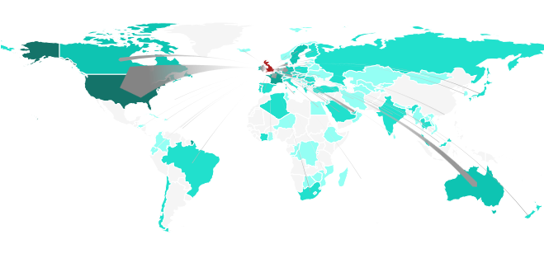
Destination countries of internationally mobile British students
Number of British students abroad: 27,377
Outbound mobility ratio: 1.2%
Source: UNESCO, Global Flow of Tertiary Education Students (2016)

Slide 11
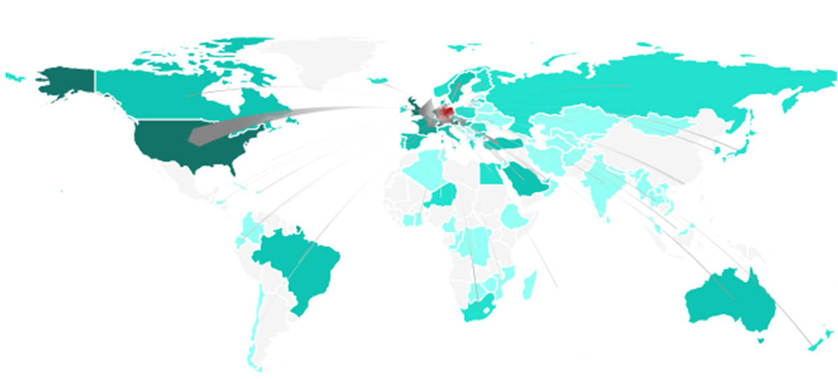
Destination countries of internationally mobile German students
Number of German students abroad: 119,223
Outbound mobility ratio: 4.3%
Source: UNESCO, Global Flow of Tertiary Education Students (2016)

Slide 12
How do language graduates fit into this context?
Students with language skills AND international experience can easily demonstrate that elusive global skills-set.
HOWEVER, many language students do not understand what their soft skills are or their uniqueness.
"I am interested in language jobs" - this self-limits options for language graduates.
languages are rarely the only thing employers look for.
Many graduate schemes will accept students from any course - yet many language students do not apply.
Students must define themselves through their skills-set and their international education/experience instead.

Slide 13
Give your students the right language to define themselves
A global graduate - International education and/or extended work experience abroad.
A global mindset - with cultural agility, maximum adaptability and extended experience of studying/working collaboratively in multicultural teams
A global skillset, which includes (but is not limited to) professional fluency in one/two foreign languages
Language graduates are added-value recruits.
Individuals with these skills can pick the work they want.
Mark Cahill, Managing Director ManpowerGroup UK, NEMEA

Slide 14
"But I don't want to work in a corporate enviroment..."
Any international institution
MI5
The Foreign and Commonwealth Office
The Civil Service (Fast Track Scheme)
The Diplomatic Service

Slide 15
References
Bridger, K (2015): Academic perspectives on the outcomes of outward student mobility. Higher Education Academy. Available on: https://www.heacademy.ac.uk/sites/default/files/resources/academic_perspectives_on_the_outcomes_of_outward_student_mobility_-_final_report.pdf
British Academy (2014): Born Global Project. Available on http://www.britac.ac.uk/policy/Born_Global.cfm
British Council (2013): Languages for the Future available on https://www.britishcouncil.org/sites/default/files/languages-for-the-future-report-v3.pdf
British Council (2015): Broadening Horizons: The value of overseas experience. Available on: https://www.britishcouncil.org/sites/default/files/broadening-horizons-report.pdf
Diamond, A et al (2011): Global Graduates into Global Leaders. Available on http://www.ncub.co.uk/reports/global-graduates-into-global-leaders.html
HEA (2014). Internationalising Higher Education Framework. Available on https://www.heacademy.ac.uk/sites/default/files/resources/internationalisingheframeworkfinal.pdf
Riordan, C (2013): UK Strategy for Outward Mobility Report. Available on http://www.international.ac.uk/media/2468186/uk-he-international-unit-uk-strategy-for-outward-mobility.pdf
UNESCO, Higher Education Statistics, various years: www.uis.unesco.org/Education/Pages/tertiary-education.aspx
UNESCO, Global Flow of Tertiary Education Students http://www.uis.unesco.org/Education/Pages/international-student-flow-viz.aspx (last accessed on 13th June 2016 )

